Slide 1
Module 4.1:
Explainable ML
Explaining automated decisions in cybersecurity
ML for Cybersecurity

Slide 2
The Right (?) to an Explanation
GDPR: “Processing should be subject to suitable safeguards, which should include specific information to the data subject and the right to obtain human intervention, to express his or her point of view, to obtain an explanation of the decision reached after such assessment and to challenge the decision...”
See https://www.privacy-regulation.eu/en/recital-71-GDPR.htm

Slide 3
The Forms Explanations Take

Slide 4
Potential Audiences
Individual data subjects
All data subjects
Regulators / policymakers
Third parties (e.g., journalists)
Global (model, all data subjects) vs. Local (one data subject)

Slide 5
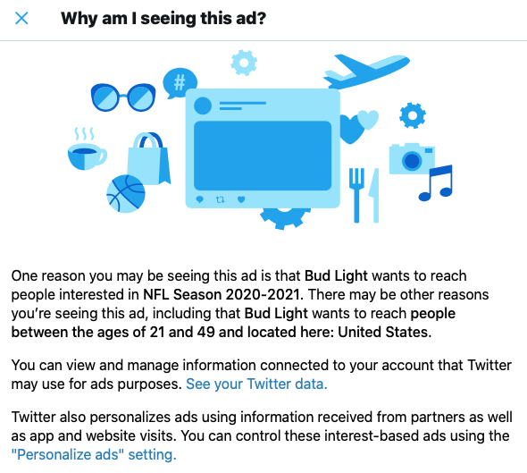
Explaining Ads to Individuals

Slide 6
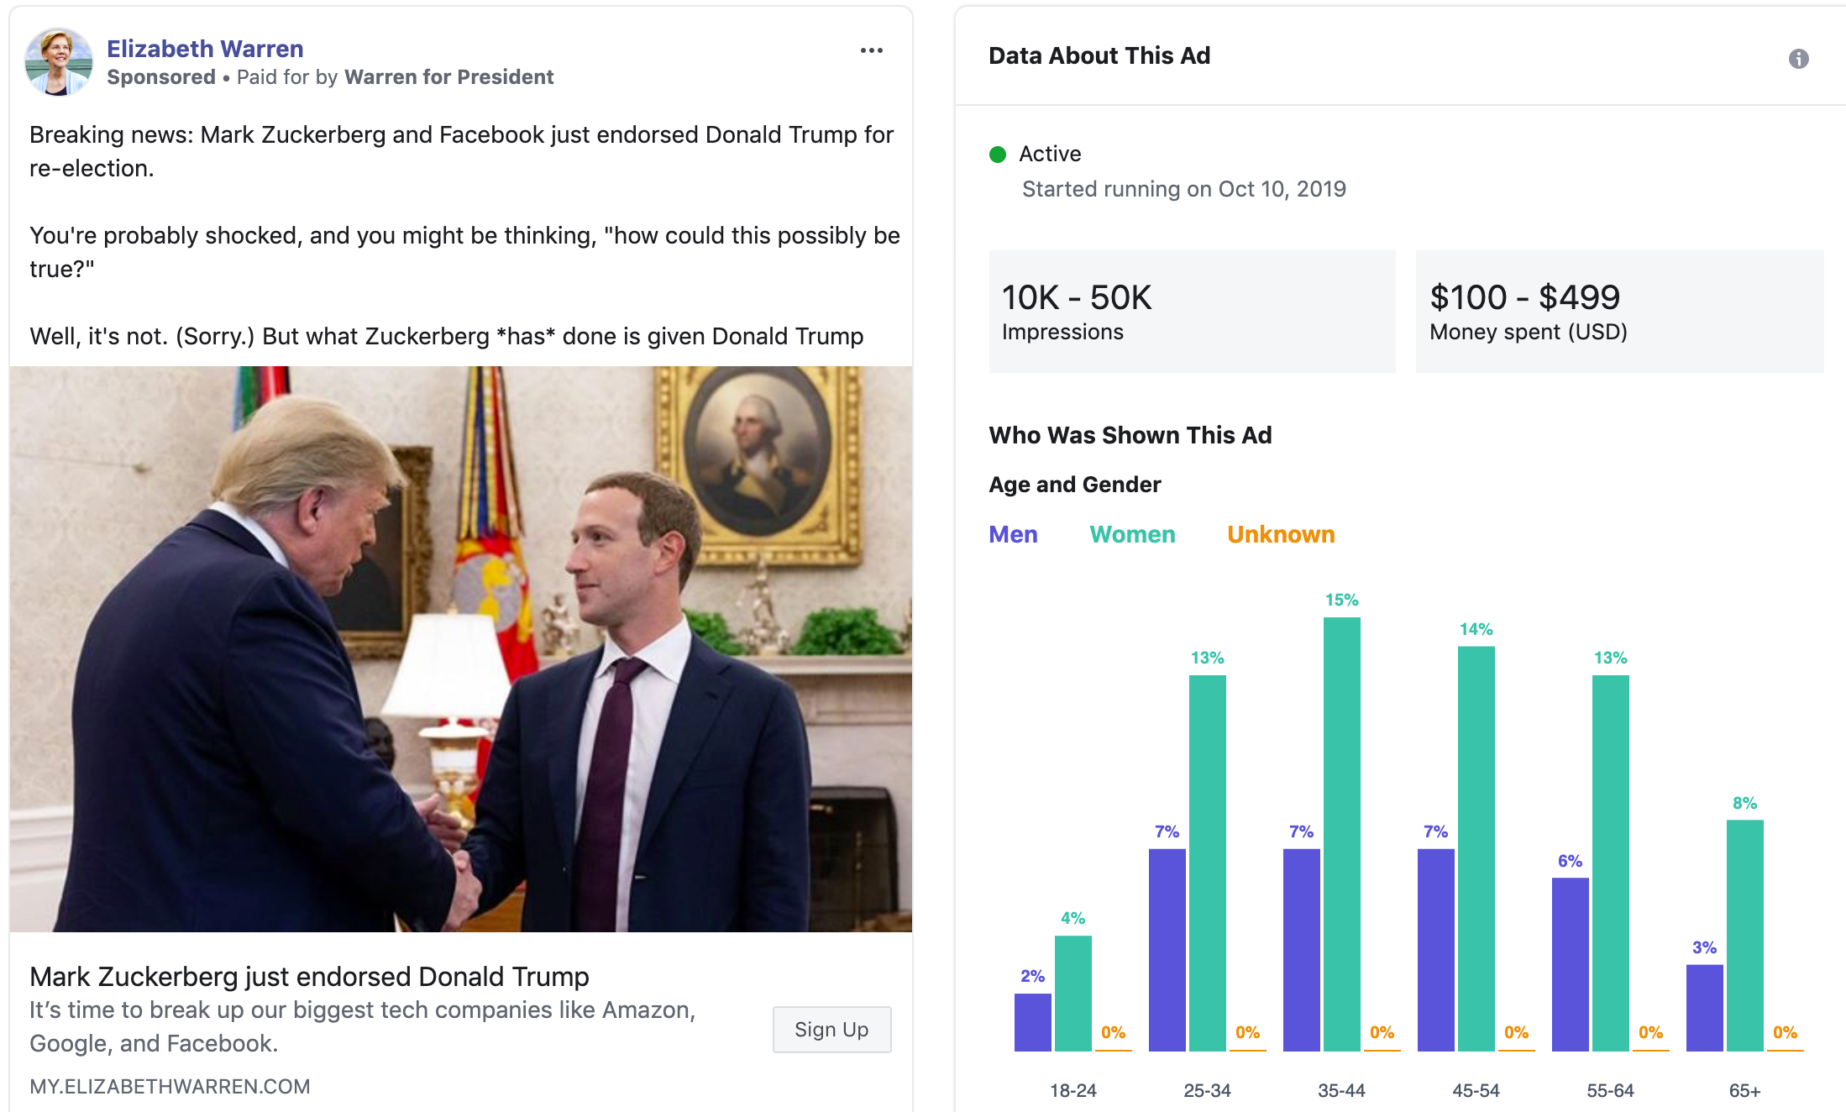
Explaining Ads in Aggregate

Slide 7
Concrete Approaches

Slide 8
Models That Are Intuitively Explainble
Give some example from Nick’s slides… like a regression model for something?

Slide 9
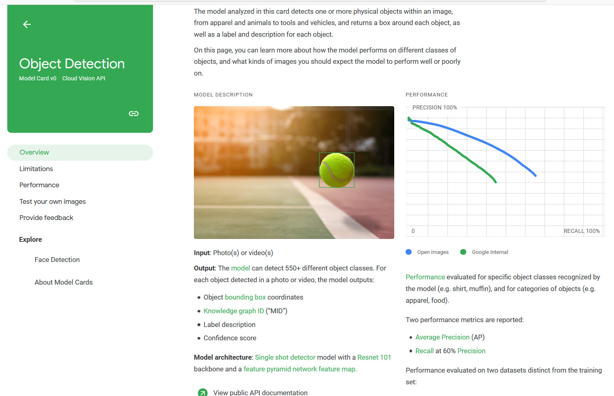
Abstract Explanations of a Model
https://modelcards.withgoogle.com/ and https://arxiv.org/abs/1810.03993

Slide 10
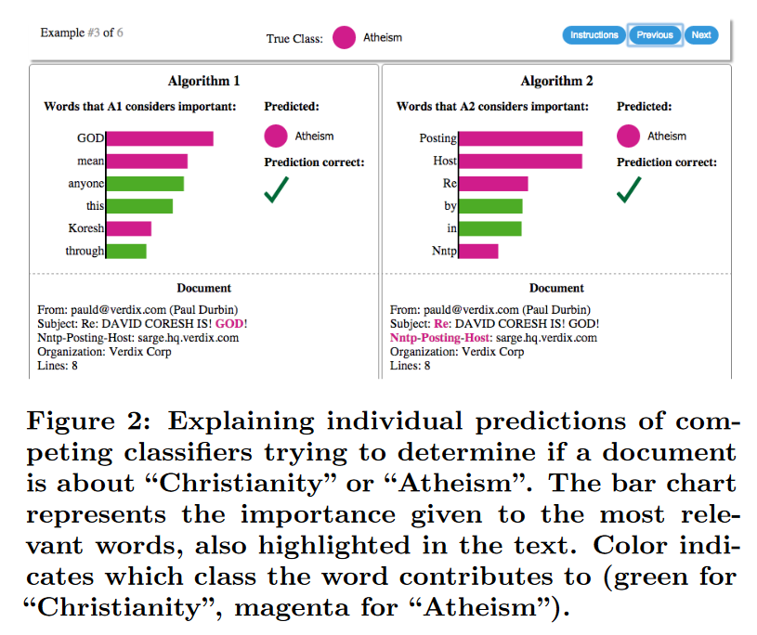
Explanations of a Single Text Classification
Taken from Ribiero et al. "'Why Should I Trust You?' Explaining the Predictions of Any Classifier," KDD 2016 https://dl.acm.org/doi/pdf/10.1145/2939672.2939778

Slide 11
Explanations of a Single Text Classification
Give some text example from Nick’s slides…

Slide 12
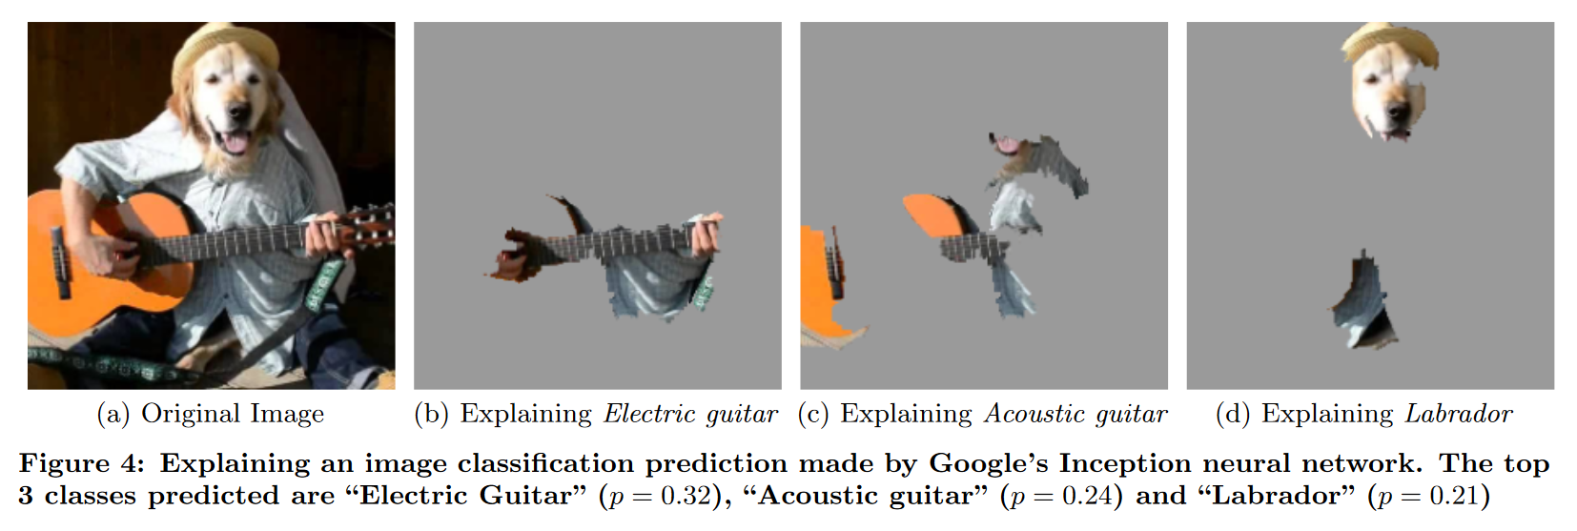
Explanations of a Single Image Classification
Taken from Ribiero et al. "'Why Should I Trust You?' Explaining the Predictions of Any Classifier," KDD 2016 https://dl.acm.org/doi/pdf/10.1145/2939672.2939778

Slide 13
Explanations of a Single Image Classification
Give some image example from Nick’s slides…

Slide 14
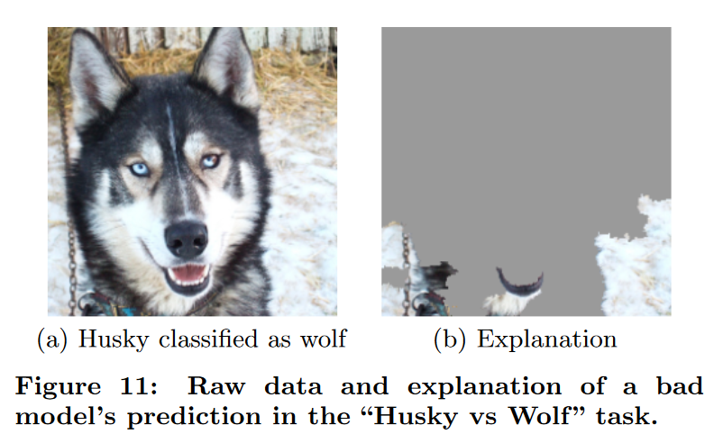
Retrospective Explanations of Images
Taken from Ribiero et al. "'Why Should I Trust You?' Explaining the Predictions of Any Classifier," KDD 2016 https://dl.acm.org/doi/pdf/10.1145/2939672.2939778

Slide 15
Retrospective Explanations of Images
Taken from Ribiero et al. "'Why Should I Trust You?' Explaining the Predictions of Any Classifier," KDD 2016 https://dl.acm.org/doi/pdf/10.1145/2939672.2939778

Slide 16
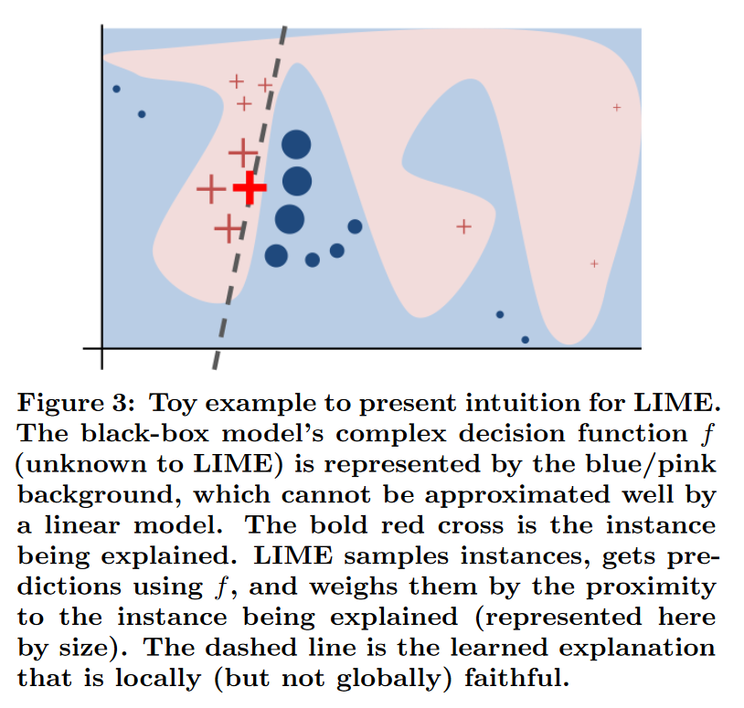
Local Explanations Despite Global Complexity
Taken from Ribiero et al. "'Why Should I Trust You?' Explaining the Predictions of Any Classifier," KDD 2016 https://dl.acm.org/doi/pdf/10.1145/2939672.2939778

Slide 17
Broader Conceptions

Slide 18
Information to Potentially Include
The general approach taken
The precise factors taken into account
Do we provide access to the data subject’s own values?
Do we explain how those factors are combined?
Do we explain the ML model used?
Do we open-source the ML model?
Counterfactuals – “If X had not occurred, Y would not have occurred”
What could a person have changed for a different classification?
Can we define some distance function and show the smallest change?

Slide 19
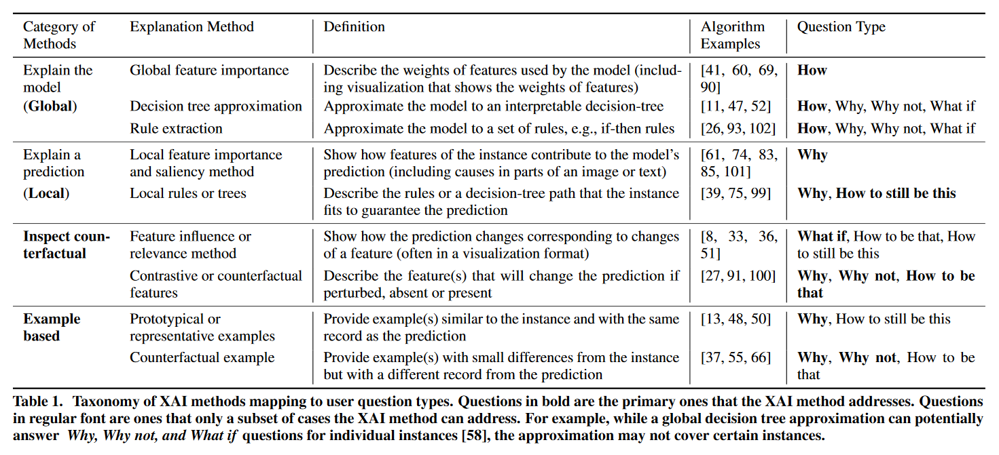
Broad Approaches
Taken from Liao et al. “Questioning the AI: Informing Design Practices for Explainable AI User Experiences,” CHI 2020.
https://dl.acm.org/doi/pdf/10.1145/3313831.3376590

Slide 20
Business Applications

Slide 21
What Explanation Would You Give?
A classifier for potential phishing emails
A classifier for images that represent hate speech
A classifier that detects DDoS attacks on your network?
To whom do you owe an explanation?
What can technical users learn from the explanation?
What can non-technical users learn from the explanation?
What can attackers learn from the explanations?
What can cause your explanations to end up in a newspaper?

